Slide 1

CSE3009 Parallel and Distributed Computing
G.GANESAN, B.E(CSE)., M.E(CSE)., M.S(IT)., MISTE., MIAENG.
ASSOCIATE PROFESSOR,
SCHOOL OF COMPUTING SCIENCE AND ENGINEERING,
VIT BHOPAL UNIVERSITY.
9500234437
ganesan.g@vitbhopal.ac.in

Slide 2

Content
  1. Mapping Techniques for Load Balancing

Slide 3
1. Mapping Techniques

Slide 4
Introduction
Once a computation has been decomposed into tasks, these tasks are mapped onto processes with the objective that all tasks complete in the shortest amount of elapsed time.
In order to achieve a small execution time, the overheads of executing the tasks in parallel must be minimized.
For a given decomposition, there are two key sources of overhead. The time spent in inter-process interaction is one source of overhead.
Another important source of overhead is the time that some processes may spend being idle. Some processes can be idle even before the overall computation is finished for a variety of reasons.
Uneven load distribution may cause some processes to finish earlier than others.

Slide 5
Introduction
At times, all the unfinished tasks mapped onto a process may be waiting for tasks mapped onto other processes to finish in order to satisfy the constraints imposed by the task-dependency graph. Both interaction and idling are often a function of mapping.
Therefore, a good mapping of tasks onto processes must strive to achieve the two objectives.
(1) reducing the amount of time processes spend in interacting with each other.
(2) reducing the total amount of time some processes are idle while the others are engaged in performing some tasks.
These two objectives often conflict with each other.

Slide 6
Introduction
For example, the objective of minimizing the interactions can be easily achieved by assigning sets of tasks that need to interact with each other onto the same process.
In most cases, such a mapping will result in a highly unbalanced workload among the processes.
In fact, following this strategy to the limit will often map all tasks onto a single process.
As a result, the processes with a lighter load will be idle when those with a heavier load are trying to finish their tasks.
Similarly, to balance the load among processes, it may be necessary to assign tasks that interact heavily to different processes.
Due to the conflicts between these objectives, finding a good mapping is a nontrivial problem.

Slide 7
Introduction
Two ways of mappings of 12-task decomposition in which the last four tasks can be started only after the first eight are finished due to dependencies among tasks.
Each mapping with an overall balanced workload that can result in different completion times.

Slide 8
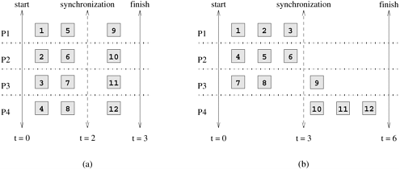
Introduction
Two ways of mappings of a hypothetical decomposition with synchronization

Slide 9
Mapping Types
Mapping techniques used in parallel algorithms can be broadly classified into two categories: static and dynamic.
The parallel programming paradigm and the characteristics of tasks and the interactions among them determine whether a static or a dynamic mapping is more suitable.
Static Mapping: Static mapping techniques distribute the tasks among processes prior to the execution of the algorithm.
For statically generated tasks, either static or dynamic mapping can be used.
The choice of a good mapping in this case depends on several factors, including the knowledge of task sizes, the size of data associated with tasks, the characteristics of inter-task interactions, and even the parallel programming paradigm.

Slide 10
1. Dynamic Mapping
Dynamic Mapping: Dynamic mapping techniques distribute the work among processes during the execution of the algorithm.
If tasks are generated dynamically, then they must be mapped dynamically too. If task sizes are unknown, then a static mapping can potentially lead to serious load-imbalances and dynamic mappings are usually more effective.
If the amount of data associated with tasks is large relative to the computation, then a dynamic mapping may entail moving this data among processes.
The cost of this data movement may outweigh some other advantages of dynamic mapping and may render a static mapping more suitable. However, in a shared-address-space paradigm, dynamic mapping may work well even with large data associated with tasks if the interaction is read-only.

Slide 11
2. Static Mapping
Static mapping is often, though not exclusively, used in conjunction with a decomposition based on data partitioning.
Static mapping is also used for mapping certain problems that are expressed naturally by a static task-dependency graph.
Static mapping schemes are based on data partitioning and task partitioning.
Mappings Based on Data Partitioning
Mappings based on partitioning two of the most common ways of representing data in algorithms, namely, arrays and graphs.
The data-partitioning actually induces a decomposition, but the partitioning or the decomposition is selected with the final mapping in mind.

Slide 12
2.1 Static Mapping: Array Distribution
In a decomposition based on partitioning data, the tasks are closely associated with portions of data by the owner-computes rule.
Therefore, mapping the relevant data onto the processes is equivalent to mapping tasks onto processes.
We now study some commonly used techniques of distributing arrays or matrices among processes.

Slide 13
2.1 Static Mapping: Array Distribution
Block Distributions
Block distributions are some of the simplest ways to distribute an array and assign uniform contiguous portions of the array to different processes.
In these distributions, a d-dimensional array is distributed among the processes such that each process receives a contiguous block of array entries along a specified subset of array dimensions.
Block distributions of arrays are particularly suitable when there is a locality of interaction,
i.e., computation of an element of an array requires other nearby elements in the array.

Slide 14
2.1 Static Mapping: Array Distribution
For example, consider an n x n two-dimensional array A with n rows and n columns. We can now select one of these dimensions, e.g., the first dimension, and partition the array into p parts.
Such that the kth part contains rows kn /p...(k + 1)n/p - 1,
where 0≤ k < p.
That is, each partition contains a block of n/p consecutive rows of A. Similarly, if we partition A along the second dimension, then each partition contains a block of n/p consecutive columns.

Slide 15
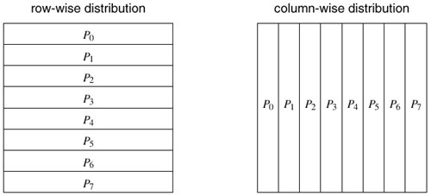
2.1 Static Mapping: Array Distribution
One-dimensional partitioning of an array among eight processes

Slide 16
2.1 Static Mapping: Array Distribution
Two-dimensional partitioning of an array among the processes
Instead of selecting a single dimension, we can select multiple dimensions to partition.
For instance, in the case of array A we can select both dimensions and partition the matrix into blocks such that each block corresponds to a n/p₁ x n/p₂ section of the matrix, with p = p₁ x p₂ being the number of processes.
In general, given a d-dimensional array, we can distribute it using up to a d-dimensional block distribution.

Slide 17
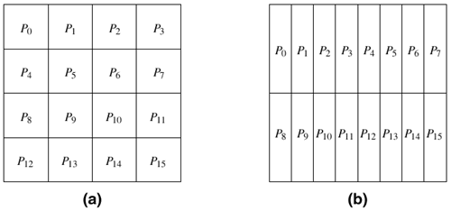
2.1 Static Mapping: Array Distribution
Two-dimensional partitioning of an array among the processes
4 x 4 process grid 2 x 8 process grid

Slide 18
2.2 Cyclic and Block-Cyclic Distribution
Cyclic and Block-Cyclic Distributions
If the amount of work differs for different elements of a matrix, a block distribution can potentially lead to load imbalances.
A classic example of this phenomenon is LU (lower–upper) factorization of a matrix, in which the amount of computation increases from the top left to the bottom right of the matrix.
The LU factorization algorithm factors a nonsingular square matrix A into the product of a lower triangular matrix L with a unit diagonal and an upper triangular matrix U.

Slide 19
2.2 Cyclic and Block-Cyclic Distribution
procedure COL_LU (A)
begin
for k := 1 to n do
for j := k to n do
A[j, k] := A[j, k] / A[k, k];
endfor;
for j := k+1 to n do
for I := k+1 to n do
A[I, j] := A[I, j] – A[I, k] x A[k, j];
endfor;
endfor;
/* After this iteration, column A[k+1 : n, k] is logically the kth column of L and row A[k, k :n] is logically the kth row of U.
*/
endfor;
end COL_LU

Slide 20
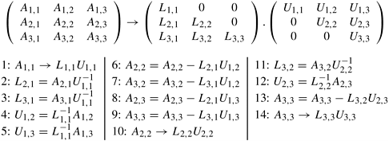
2.2 Cyclic and Block-Cyclic Distribution
Algorithm, A serial column-based algorithm to factor a nonsingular matrix A into a lower triangular matrix L and an upper-triangular matrix U.
Matrices L and U share space with A. On Line 9, A[i, j] on the left side of the assignment is equivalent to L [i, j] if i > j; otherwise, it is equivalent to U [i, j].
A decomposition of LU factorization into 14 tasks.

Slide 21
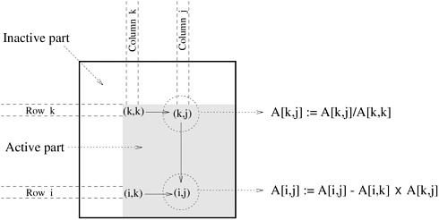
2.2 Cyclic and Block-Cyclic Distribution
A typical computation in Gaussian elimination and the active part of the coefficient matrix during the kth iteration of the outer loop.

Slide 22
Discussion

